Slide 1
Crime Scene Photography
By
Lum Farr
Department Chair
Criminal Justice Division
Forensic Science Lab Coordinator

Slide 2
Objectives of Crime Scene Photography
The objectives of crime scene photography are to record the condition of the crime scene before alterations occur, record the location and position of evidence items collected, document the point of view of principals and potential witnesses, and document spatial relationships of pertinent items.

Slide 3
Objectives of Crime Scene Photography
Photography is NOT a substitute for notes or sketches.
Is a supplement for other modes of crime scene documentation
Plays a role in the reconstruction of events of the crime.

Slide 4
Number of Photographs at the Scene
It is better to take too many photographs rather than too few.
The position of evidence items can never be reproduced exactly after they are moved, hence the photographs must be taken before any disturbance of the scene whenever possible.

Slide 5
Conditions at the Scene
Small or Large.
Lighting, weather and security present the greatest challenges.
When taking photos, ask these questions:
  Why am I taking this photograph?
  Does object have any relationship to the scene or other items of potential value?
  Will the photo represent what I saw?

Slide 6
Conditions at the Scene
  Will the object be distorted or out of perspective with other things at the scene?
  Will the object be properly exposed?
  Will there be reflections off other objects?
  Will I recognize the photo after development?
  Will I be able to explain the photo to the jury?

Slide 7
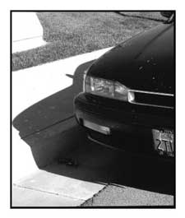
Photo – What is it?

Slide 8
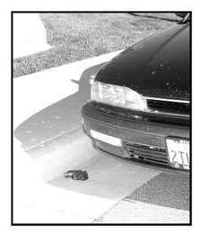
Now What is it?

Slide 9
Choice of Camera
Best camera is the (SLR): Single Lens Reflex.
Comes in manual focus to fully automatic focus.
Has automatic flash and automatic winding.

Slide 10
Choice of Camera
Comes with lenses suited for both long-range and close-up (macro) photographs.
Comes with zoom lens (35 to 70 mm) with Macro capability coupled with long-range zoom (80 – 200 mm).
Good for all but specialized circumstances.

Slide 11
Type of Film
Color print is film of choice. Has replaced black-&-white for all forensic application except for special needs.
    Latent Prints
    Infrared Photography
    Photographs for research or publications
Many types of evidence cannot be easily distinguished from the background when using B&W film.

Slide 12
Polaroid Film at the Scene
In certain circumstances, may be needed.
When imperative that the photos are acceptable, may need a Polaroid.
  Photos of impressions in soil prior to casting.
  Photos of latent prints impressions prior to lifting
  Photos of bloodstains prior to collection.
  Has film usage in both Positive/Negative application.

Slide 13
Digital Imaging Cameras
Image is captured on a disk.
Can review image/photo immediately.
Can print copies of the image when needed or can send image over the Internet to Prosecutor or others.

Slide 14
Digital Imaging Cameras
Disadvantage:
  Image can be manipulated by computer whiz.
    Must document each photo accurately to prevent question of suspect photo.
  Lack of resolution as compared to SLR.
  Lack of resolution in blow-up photos

Slide 15
Digital Imaging Cameras
Advantage:
  Ability to illustrate photo on TV monitors.
    Beneficial for court room presentations.
  Easy to prepare copies of each photo.
    Can be transferred to floppy disks, CD-ROM writable disks, or ZIP disks for storage or transfer to another agency.

Slide 16
Suggested Systematic Approach
Paramount consideration is a systematic procedure to ensure all necessary photographs are taken of the crime scene.
Sequence of photgraphs should follow closely the sequence of sketch preparation.

Slide 17
Log Photographs
Keep a photo log of all photographs taken.
Try to always use a two member team.
Log should include:
  Data regarding camera
  Type film
  Lens used

Slide 18
Log Photographs
  The roll number and frame number for each photograph
  Exposure data
  Description of the content of each frame.
  Keep photographs as a permanent record in the case file.

Slide 19
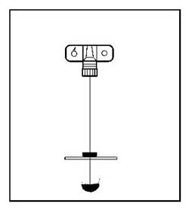
Close-up Photographs
Use close-ups for finer detail of any item.
Shoot item at 90-degree angle using a ruler to minimize distortion.

Slide 20
Point of view of witnesses
Take photos from where the witnesses or principals were standing to illustrate their view during crime.
Make sure CS sketches show exact distances depicted in the point-of-view to coincide with photo taken.

Slide 21
Photography of Latent Impressions
Photo all developed latents prior to lifting.
Best film is B&W. (Better contrast)
Always use a measurement scale in photo.
Patent impressions in blood should be photographed with color film rather than B&W.

Slide 22
Photography of Wounds
Photo wounds both before and after cleaning.
Center the camera on the wound. Most body parts are rounded (be careful)
Re-photograph every day. (sometimes twice a day). Bruising will change rapidly.

Slide 23
Photography of Wounds
For deceased individuals, re-photograph after embalming. Embalming can enhance the wound or bruising.
For bite marks use the ABFO #2 (American Board of Forensic Odontology) scale.

Slide 24
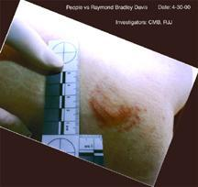
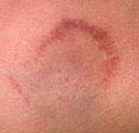
Photography of Wounds
Center the ABFO scale between the horizontal and vertical legs of the scale.
Camera lens should be centered on the wound.

Slide 25
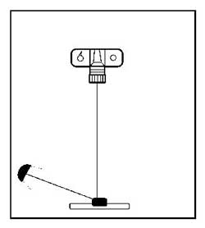
Photography of Wounds
The flash unit should be held to one side to produce oblique lighting.

Slide 26
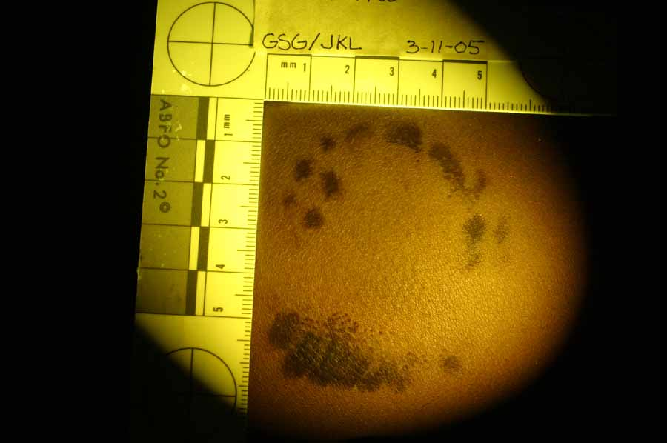
Photography of Wounds
Oblique lighting will help highlight the indented impressions.
On bite marks, oblique lighting may be crucial to the reproduction of the wound’s features.

Slide 27
Film Type
Five Basic type of B & W film
  1. Blue sensitive
    Used for extremely high resolving power.
  2. Orthochromatic:
    Includes Green but not Red and Orange
  3. Panchromatic
    Standard film.
  4. Infrared
    Beyond the visible spectrum (heat-sensitive)
  5. X-ray
    Used for Medical Purposes

Slide 28
Color Film
Three major types:
  Agfa:
    Uses dye couplers immobilized by long chain hydrocarbon residue to prevent diffusion.
  Ektachrome:
    Resin-protected dye couplers dispersed in emulsion.
  Kodachrome:
    Nonsubstantive dye couplers in processing solutions.

Slide 29
Film Speed
A way of measuring sensitivity to light.
The faster the film the more sensitive the film is to light.
Two common measuring features:
  ASA (American Standard Association) based on arithmetic scale.
  DIN (Deutche Industrie Norm) based on a logarithmic scale.

Slide 30
Infrared Photography
Uses infrared film.
Records images formed by infrared light.
Used in questioned documents to locate and document alterations.
Used in aerial photography to assist in locating gravesites.
Used in crime labs to detect and document gunshot residues on bloody or dark fabrics.

Slide 31
Ultraviolet Photography
Used to document materials that glow under ultraviolet light.
  (Semen, certain fibers, latent fingerprints dusted with fluorescent powders)
Usually taken with B & W and a filter that allows only ultraviolet light to pass
Used to photo body wounds such as bitemarks.

